Slide 1




Where to Open the Next Fast Food Restaurant
Thomas Gresco, Andrew Li, Euribiades Mota, and Vineetha Ramachandra

Slide 2

Essential Questions:
How does the population relate to the total number of fast food restaurants in a given state?
How does the population percent change relate to the total restaurants
How does the average household income compare to the total population and restaurants?
What is the best location in our specified state to open a restaurant?

Slide 3
Motivation:
1. Interest in Owning a Business/Franchise or helping others who have this desire
2. An interest in the profitability of the fast food industry and fast food companies themselves

Slide 4




01
Population vs Number of Fast Food Restaurants

Slide 5
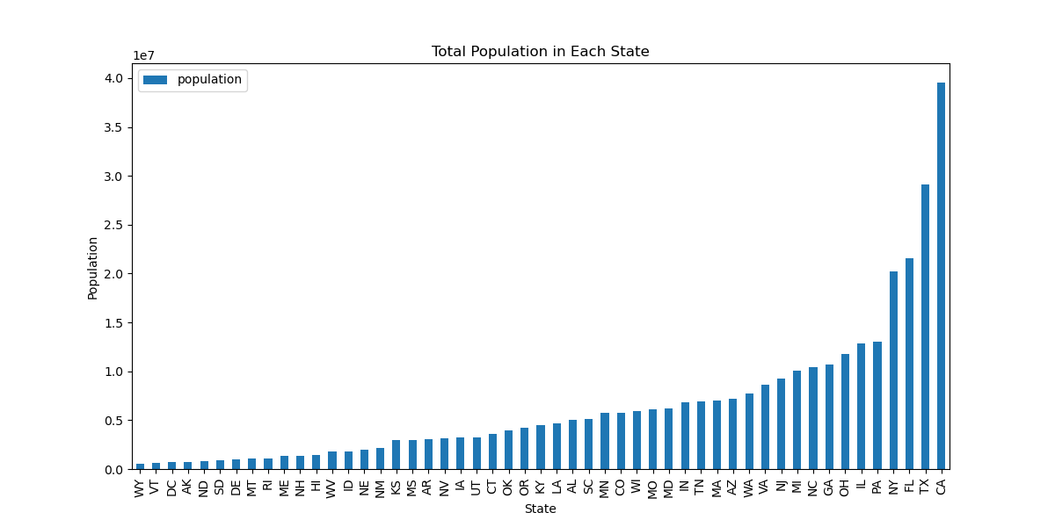

Slide 6
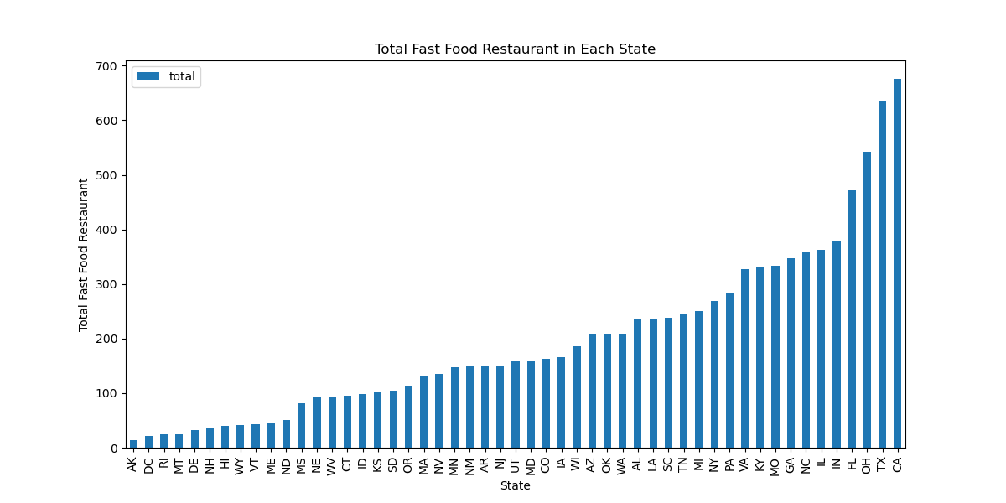

Slide 7
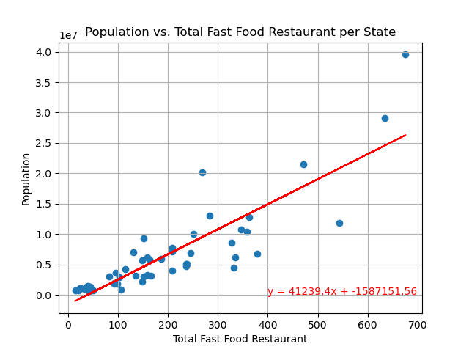

Slide 8
Analysis:
The “r” value is 0.86 which represents a strong positive correlation
From the bar graphs it is evident that as the population increases, so does the total number of fast food restaurants in most cases.
This is further supported by the scatter plot that shows the total number of restaurants is increasing with the total population.

Slide 9
02
How does the population percent change relate to the total restaurants

Slide 10
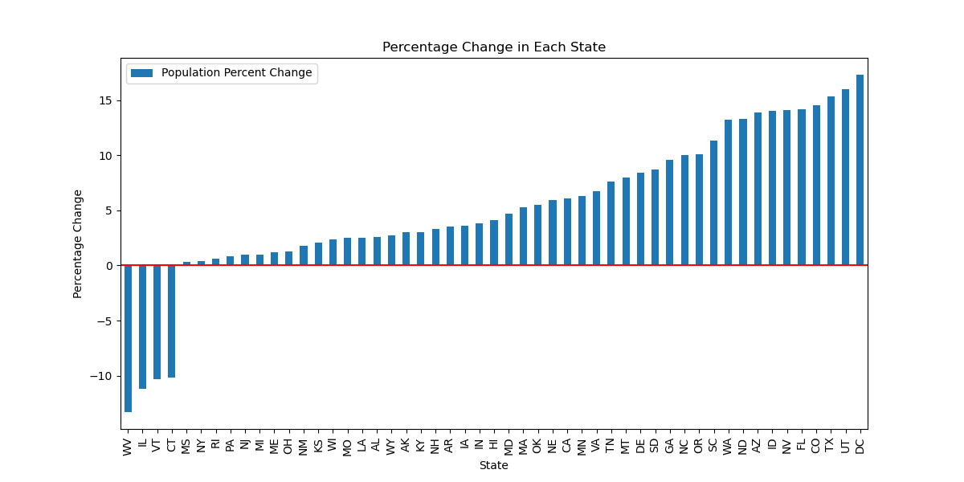

Slide 11
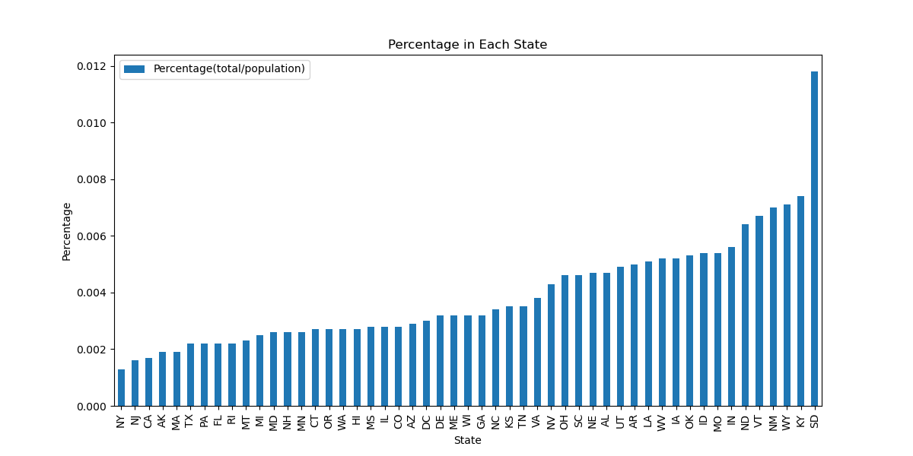

Slide 12
Analysis:
From the second bar graph it is evident that states with a smaller population had a higher ratio of restaurants to the total population.
South Dakota ranks in the bottom five states in terms of total population (excluding Washington D.C.) but has the highest ratio shown in the second bar graph.
As the population changes, the number of fast food restaurants fluctuates alongside it. When the population decreases the number of fast food restaurants declines and vice versa.

Slide 13
03
How does the average household income compare to the total population and restaurants?

Slide 14
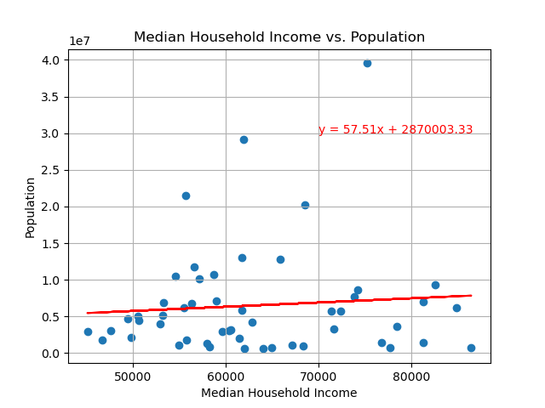

Slide 15
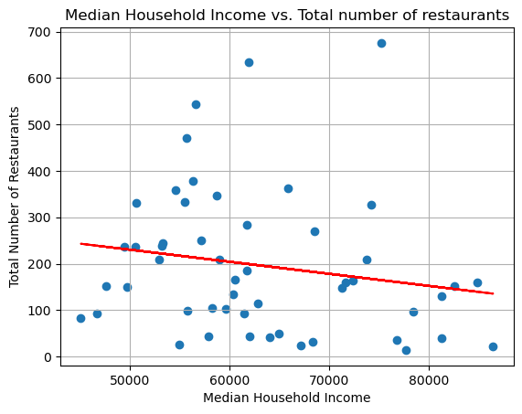

Slide 16
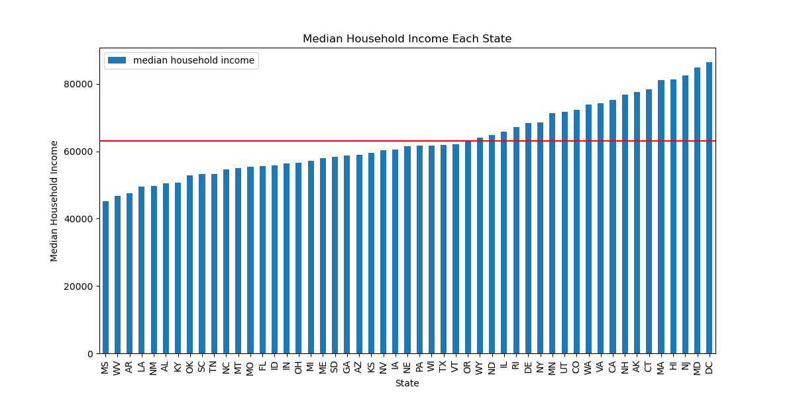

Slide 17
Analysis:
The median household income was about $63,000
From Wyoming to the right are states above the median. This helps us gauge which states have higher poverty rates.
Based on the scatter plot that shows median household income vs population, there is a very weak positive correlation between the two.
The “r-value” is 0.08 which is very close to zero and represents what is being shown on the graph as the regression line looks almost straight.
As income increases the total number of restaurants decreases

Slide 18
04
Where is the best location in the state to open?

Slide 19
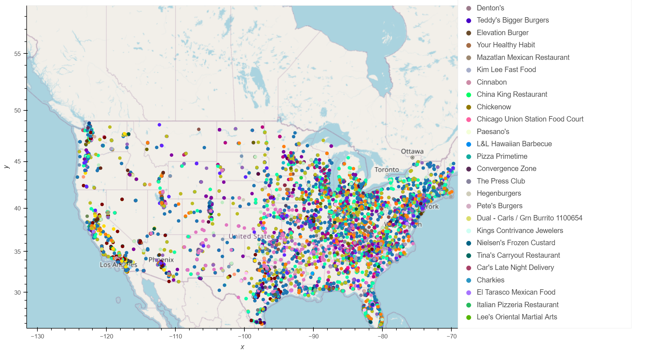

Slide 20
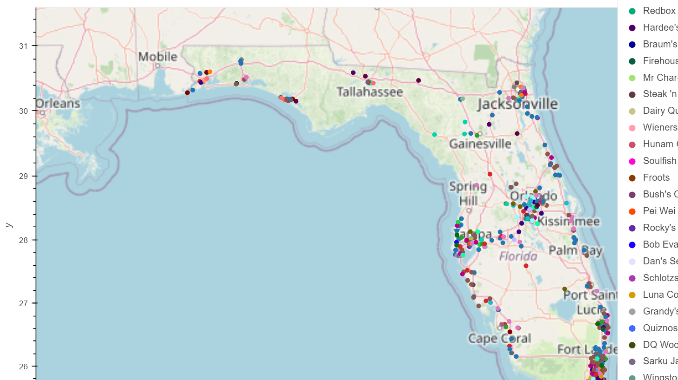

Slide 21
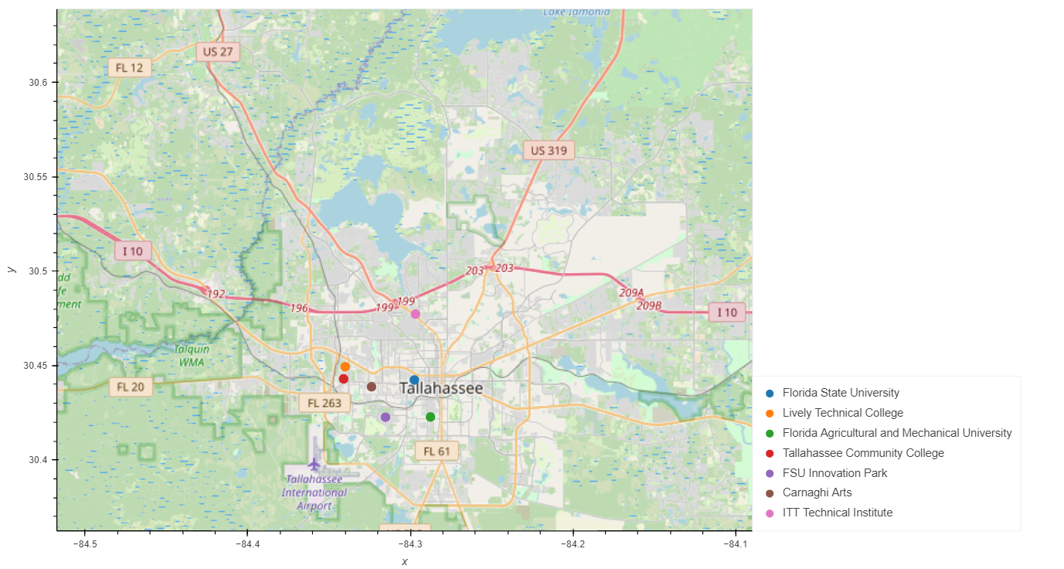

Slide 22
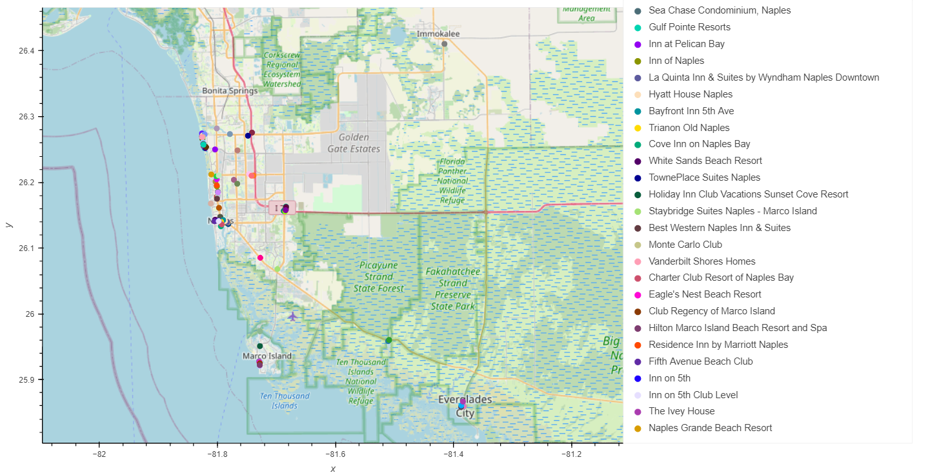

Slide 23
Conclusions:
We chose Florida as the best location to open our next fast food restaurant
Based off the data, although Florida is in the top 5 in total population and number of fast food restaurants, the ratio of restaurants to people is very small and population continues to increase in Florida
We found that as the median household income increased, there were less fast food restaurants.
Despite being on the lower end of median household income, Florida had many areas that did not have an abundance of fast food restaurants.

Slide 24
Conclusions:
Two areas in Florida that we deemed suitable to open a new fast food restaurant are in Tallahassee and near Naples.
Tallahassee is home to Florida State University. According to Jacqueline Howard of CNN, people aged 20-39 eat more fast food than any other age group. Although, this is a large age spread, college students fit directly in to this.
The final map shows hotels around Naples. There are an abundance of hotels as it is a big vacation spot, but if you look at the map of Florida there are not many fast food restaurants.
Notes:
https://www.cnn.com/2018/10/03/health/fast-food-consumption-cdc-study/index.html

Slide 25
Implications:
It is evident that there are an abundance of fast food restaurants in the United States, but there are still plenty of locations to add more.
These findings can be used to look in to other specific states outside of Florida.
For future research, we can do more research on specific fast food restaurant’s yearly revenue and revenue changes.
Other points of new research could include demographics from specific states, such as ethnicity and race. These could factor in to the success of a fast food restaurant.

Slide 26
Where the data was found:
Demographics Data:
Fast Food Data:
The data was found on “Kaggle”
This is a list of over 10,000 restaurants
Includes the name, address, latitude and longitude of each place
This data was found using the “CORGIS Dataset Project”
This data was provided by Ryan Whitcomb, Joung Min Choi, Bo Guan
Includes many different demographics for each state, such as income, population, and age.

Slide 27
How the data was found:
Demographics Data:
Fast Food Data:
Google Search
Looked through multiple websites to see where the best and most reliable csv file could be found
Google Search
Went through Census Data
Looked through multiple csv files to find one that included all aspects that would help us answer our essential questions

